Slide 1
Convective Mass Transfer & Mass Transfer Coefficient

Slide 2
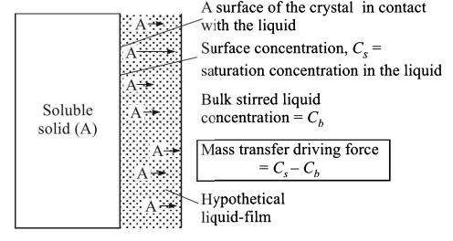
Convective Mass Transfer
Case-1

Slide 3
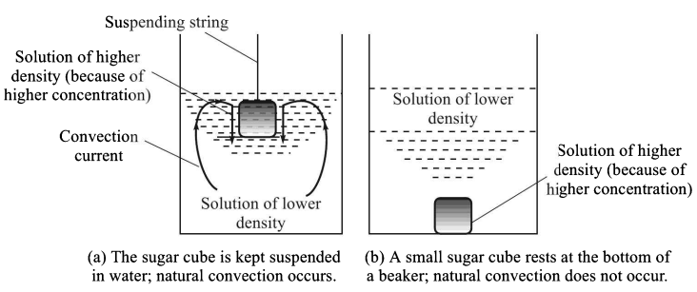
Case-2
Convective Mass Transfer

Slide 4


Mass Transfer Coefficient

Slide 5
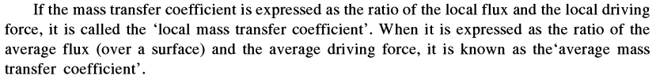
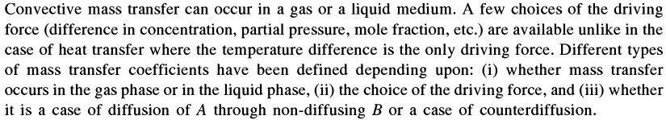
Mass Transfer Coefficient

Slide 6
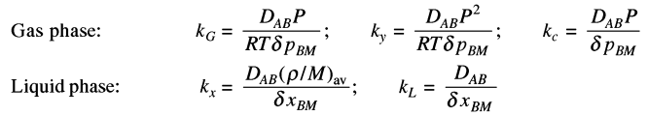
Diffusion of A through non-diffusing B
By comparing Gas phase (diffusion of A in non-diffusing B) and liquid phase diffusion coefficient

Slide 7
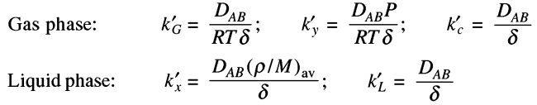
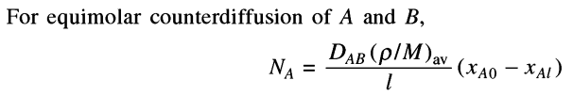

Equimolar Counter diffusion of A and B
Comparing these two equations with molecular diffusion in gas phase and liquid phase equimolar counter diffusion of A and B

Slide 8

Where,

Slide 9
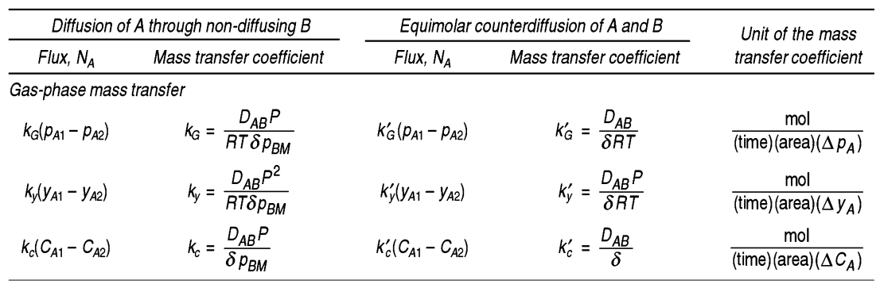

Slide 10
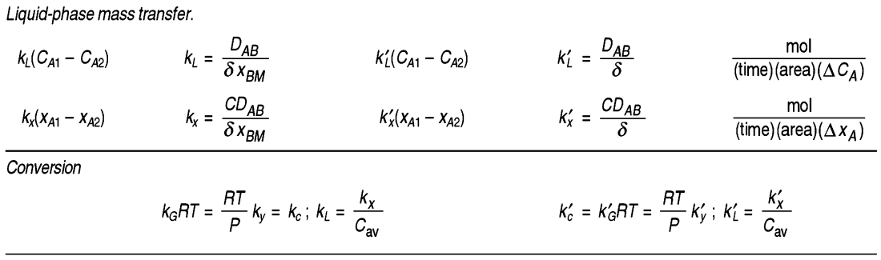

Slide 11
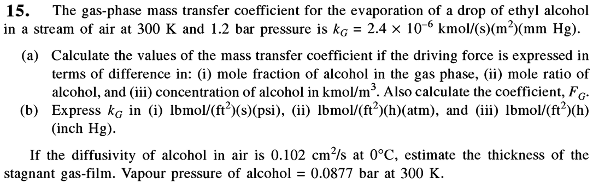

Slide 12
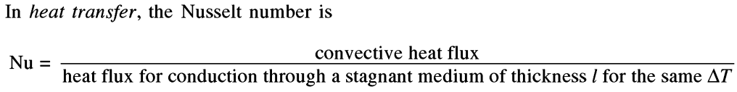

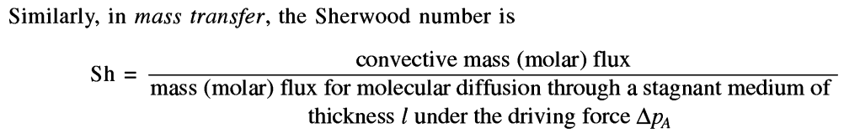

Dimensionless Groups in Mass Transfer

Slide 13
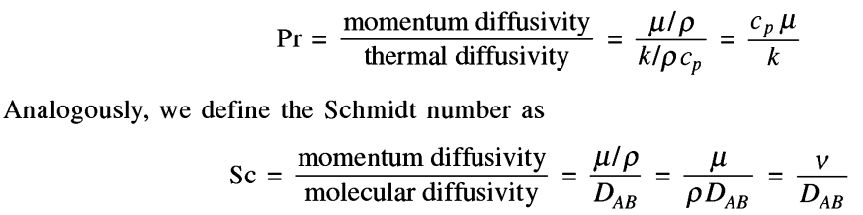
Dimensionless Groups in Mass Transfer

